Slide 1
Express Request Data
Query String Parameters | Posting Form Data | Route Parameters | Route Parameter Middleware
Notes:
Welcome to our lecture on express request data. In this lecture we will go through query string parameters, posting form data, route parameters, and route parameter middleware. Let’s start the video lecture.

Slide 2

Query String
Purpose: Capture values after "?" in a URL.
Parsing: Automatically parsed and stored in req.query.
Access: Access values using req.query.paramName.
Notes:
Now, let's talk about query strings in Express. Query strings capture values from the URL after the question mark symbol. These values are automatically parsed and stored in req.query. You can access these values by referencing req query param Name, which allows you to easily retrieve data passed in a URL's query string for further processing in your routes.

Slide 3
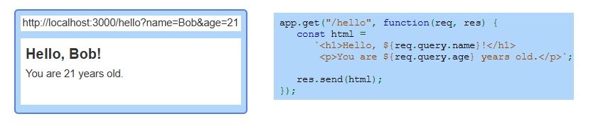
Example
Notes:
Here is an example of using query strings to capture data from the URL. In this case, the browser sends a name and age as query parameters. The server receives these parameters and dynamically generates a response that includes the name and age in the message. This demonstrates how to retrieve and display query string values within your application.

Slide 4
Posting Form Data
Data Format: Form data is URL-encoded and sent in the request body.
Parsing Middleware: Use express.urlencoded() to parse the data.
Access Data: Parsed values are stored in req.body.
Notes:
Now, let's look at posting form data. When a form submits data, it is URL encoded and sent in the request body. To handle this, you use middleware to parse the data and make it accessible. The parsed values are then stored in the request object, where you can easily access them in your route handlers. This is essential for processing form submissions in Express.

Slide 5
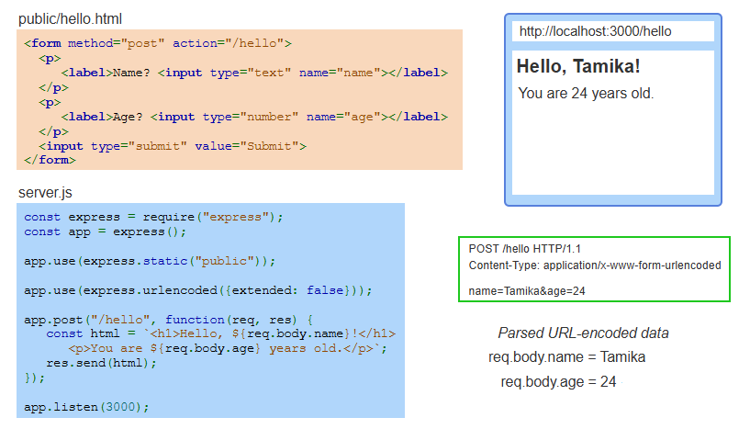
Example
Notes:
In this example, a form is used to submit data, such as the user's name and age. The server receives this form data via a POST request. The form is URL-encoded and parsed using middleware, making it accessible in the request object. The server dynamically generates a response that displays the name and age of the user based on the submitted data.

Slide 6
Route Parameters
Purpose: Capture dynamic data from the URL path.
Syntax: Defined with a colon (e.g., /users/:username).
Access Data: Stored in req.params (e.g., req.params.username).
Notes:
Route parameters allow you to capture dynamic data directly from the URL. They are defined by using a colon in the route definition. The captured data is then stored in the request object's params property, enabling you to access and utilize it within your route handler for dynamic processing and responses.

Slide 7
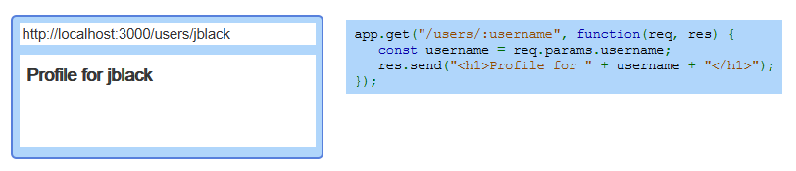
Example
Notes:
In this example, a route is set up to capture a dynamic value from the URL. The value is used to display a personalized message. When a user accesses the route with a specific username, the server captures that username and returns a response showing the profile for that user. This demonstrates how route parameters can be used to create dynamic, user-specific content.

Slide 8
Route Parameter Middleware
Purpose: Runs before the route's callback to process route parameters.
Method: Use app.param(paramName, middlewareFunction).
Access Value: Fourth parameter contains the route parameter's value.
Example: Modify req object (e.g., add req.user with name and username).
Notes:
Route parameter middleware is used to process route parameters before the route's callback function is executed. It is set up using the param method, where the parameter name and middleware function are defined. The middleware function receives the route parameter's value in the fourth parameter, allowing you to modify the request object, such as adding user details.

Slide 9
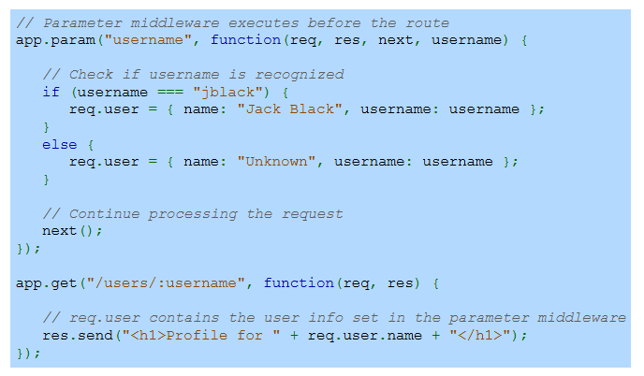
Example
Notes:
In this example, route parameter middleware processes the username before the main route function. If the username is recognized, user information is added to the request object. This middleware runs before the route's callback, where the request is then processed. The route sends back the profile with the user's name based on the parameter middleware.

Slide 10
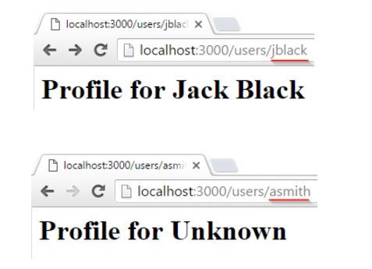
Example (Continue)
Notes:
In this continued example, when accessing the route with a known username, the profile page correctly displays the associated name. For an unrecognized username, the middleware assigns a default value, and the profile page shows "Unknown." This demonstrates how route parameter middleware can be used to dynamically handle user data based on the URL input.

